Slide 1




ECE 2050 Digital Logic and Systems
Vivado tutorial

Slide 2
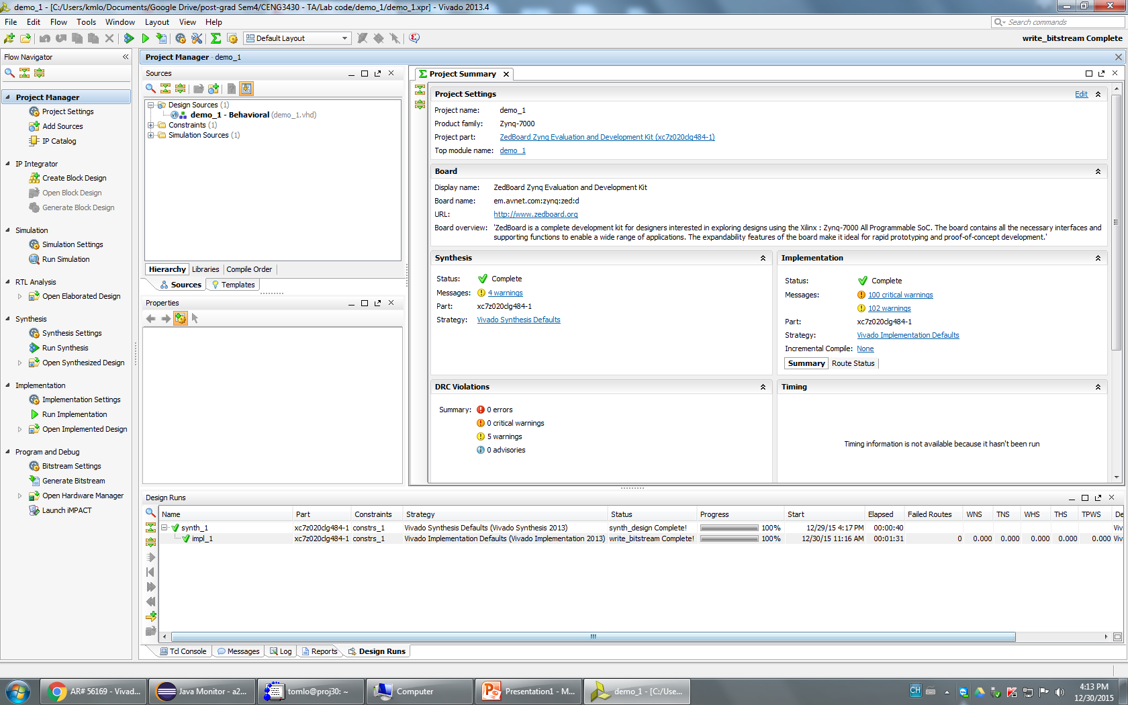
Vivado
Programming using IDE for VHDL / Verilog
Running simulation to test your design
Download the compiled code to FPGA board

Slide 3
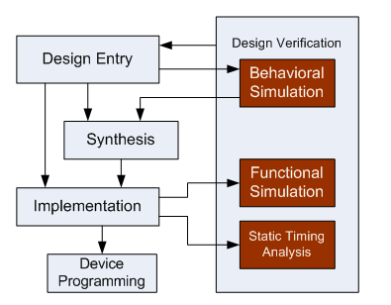
What is simulation?

Slide 4
Step 1: Start the software
Double click the Vivado icon in the desktop
Or start from the Start Menu

Slide 5
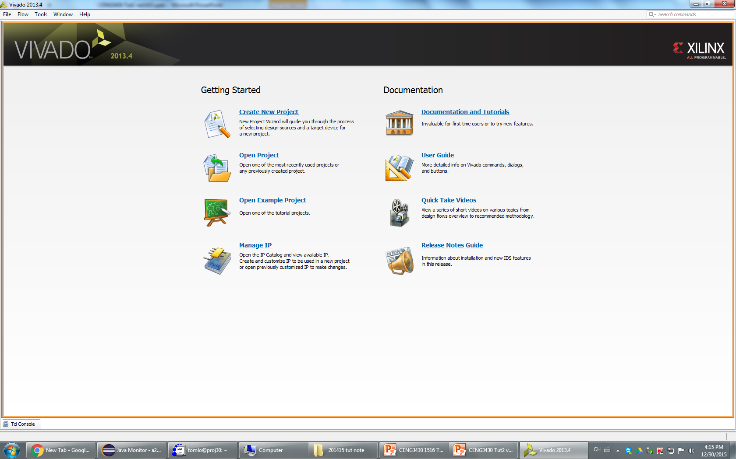
Step 2: Create a new project
Or Click File -> New Project…

Slide 6
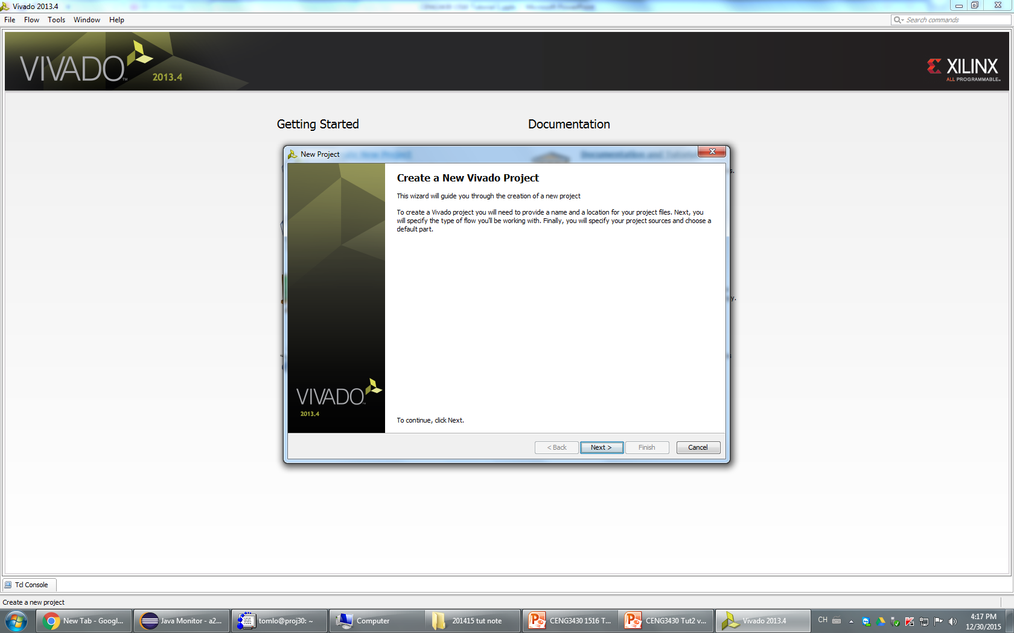
Step 3 : Click Next

Slide 7
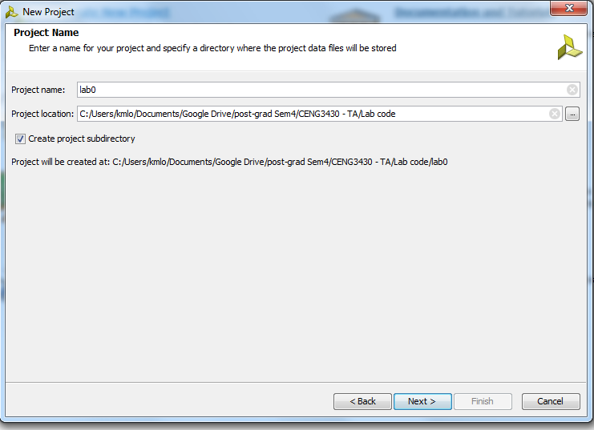
Step 4: Enter the project name
Select the project location for storage

Slide 8
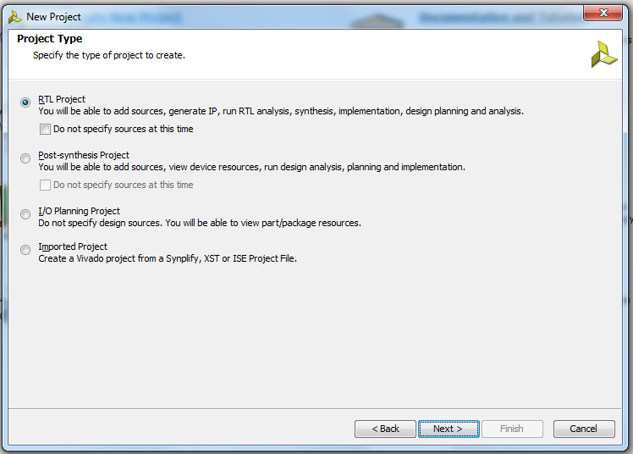
Step 5: Select RTL Project -> Next

Slide 9
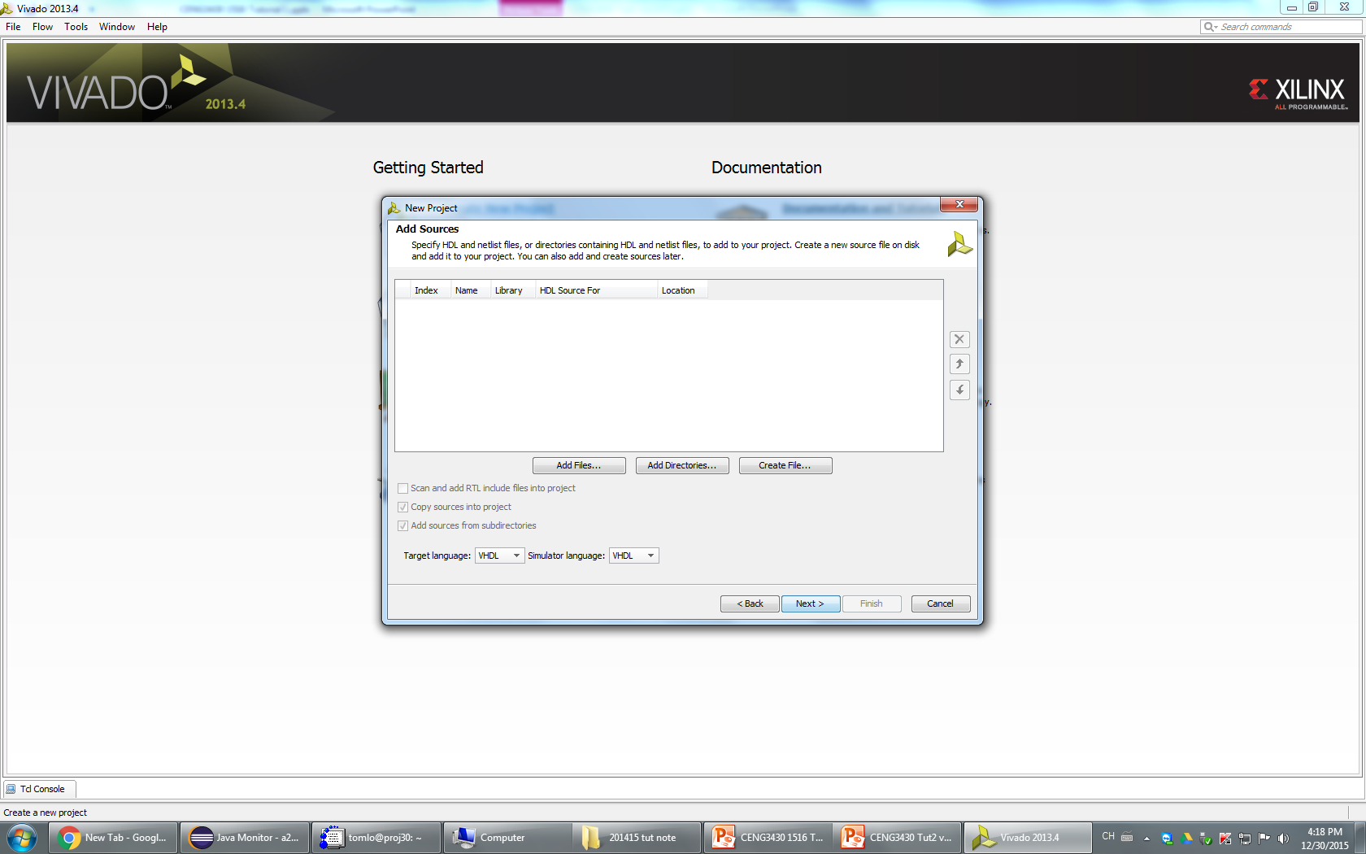
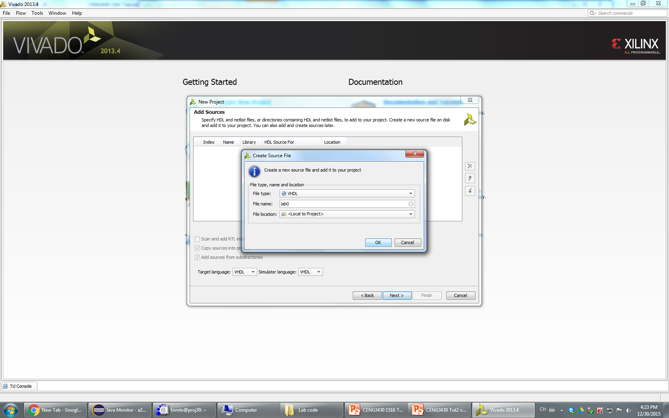
2
1
↑3
Step 6:
1. Select Target language and simulator language as “VHDL”
2. Click “Create File”
Make sure the File type is VHDL
Give name to the source file
Click OK
3. Click Next

Slide 10
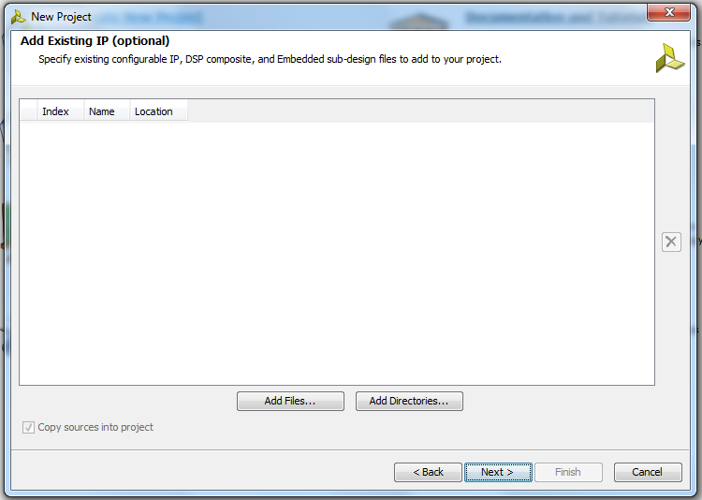
Step 7: Click Next

Slide 11
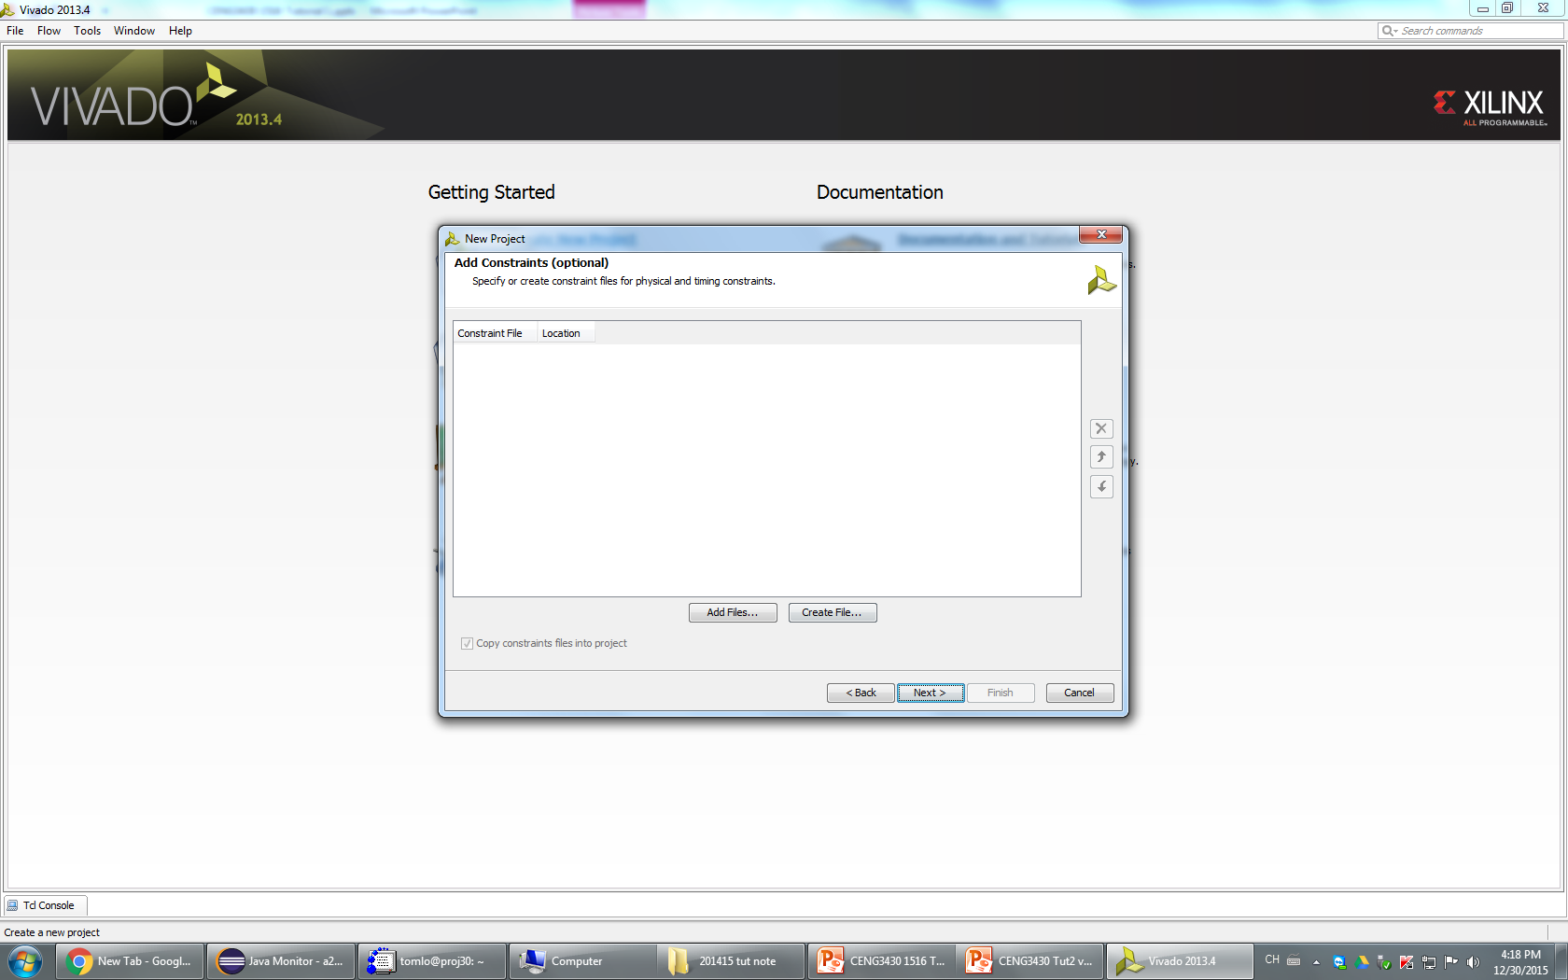
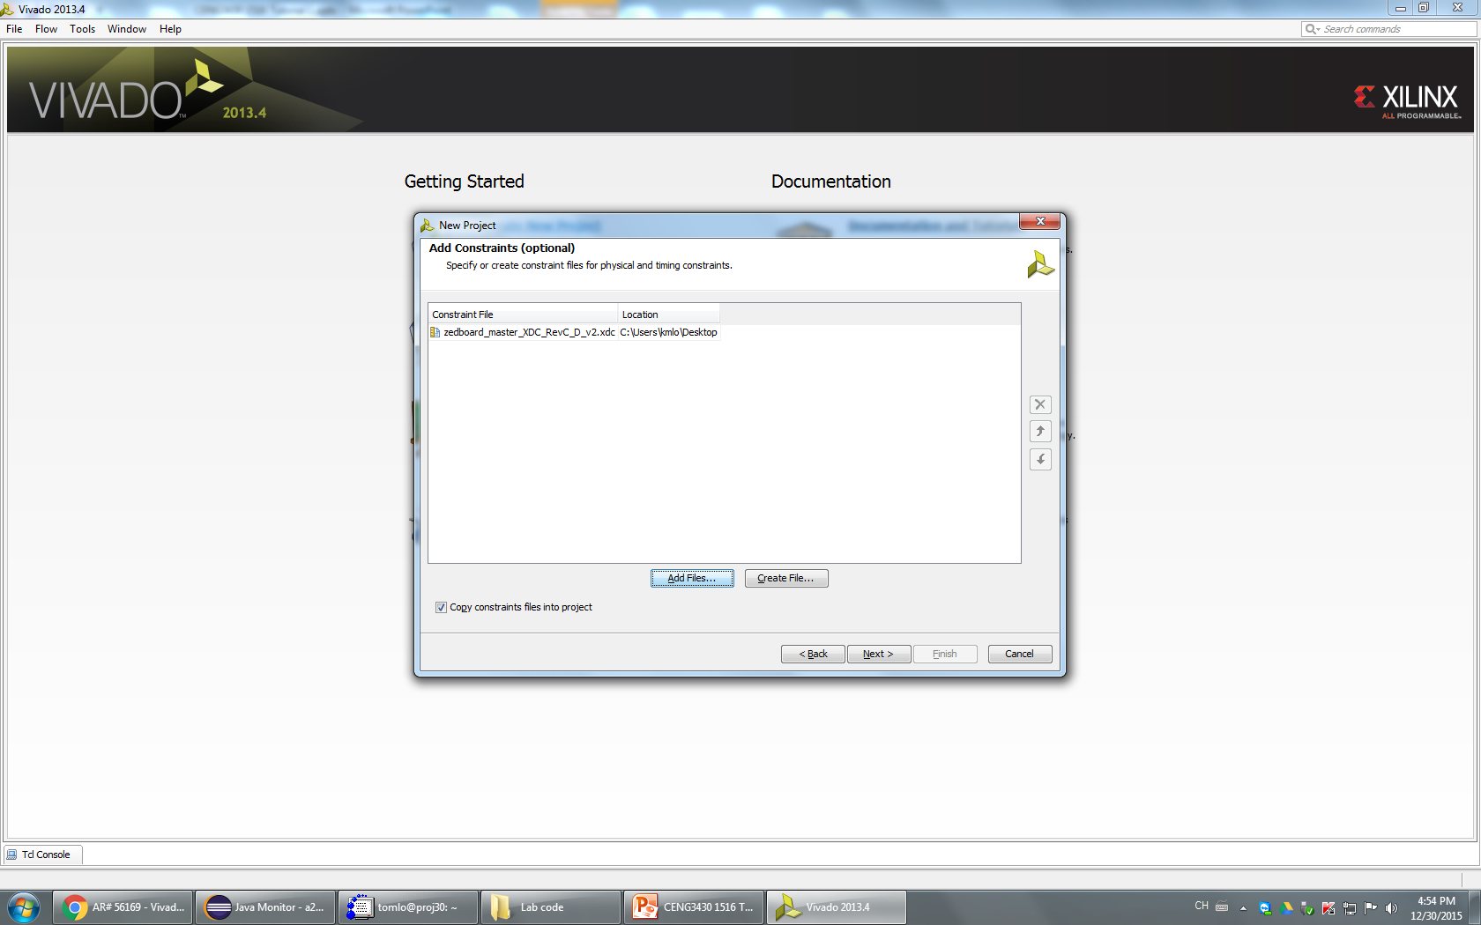
Step 8: Click Add Files, select the downloaded XDC file
Press Next or Press Next if no XDC file

Slide 12
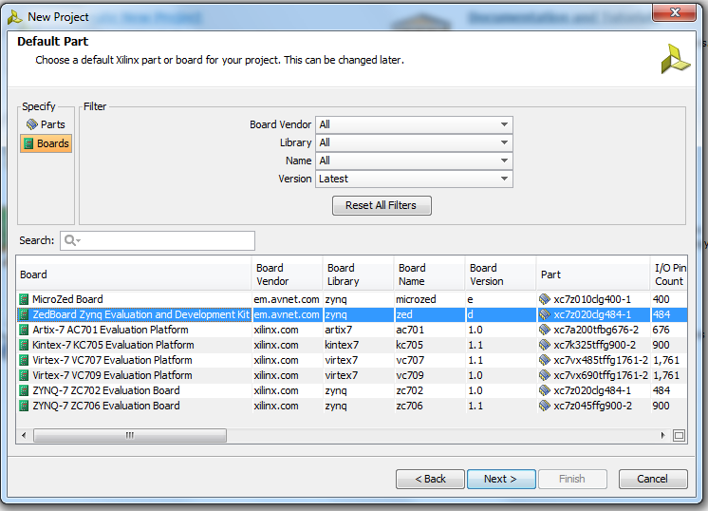
Step 9: Click Boards -> Select Zedboard -> Click Next

Slide 13
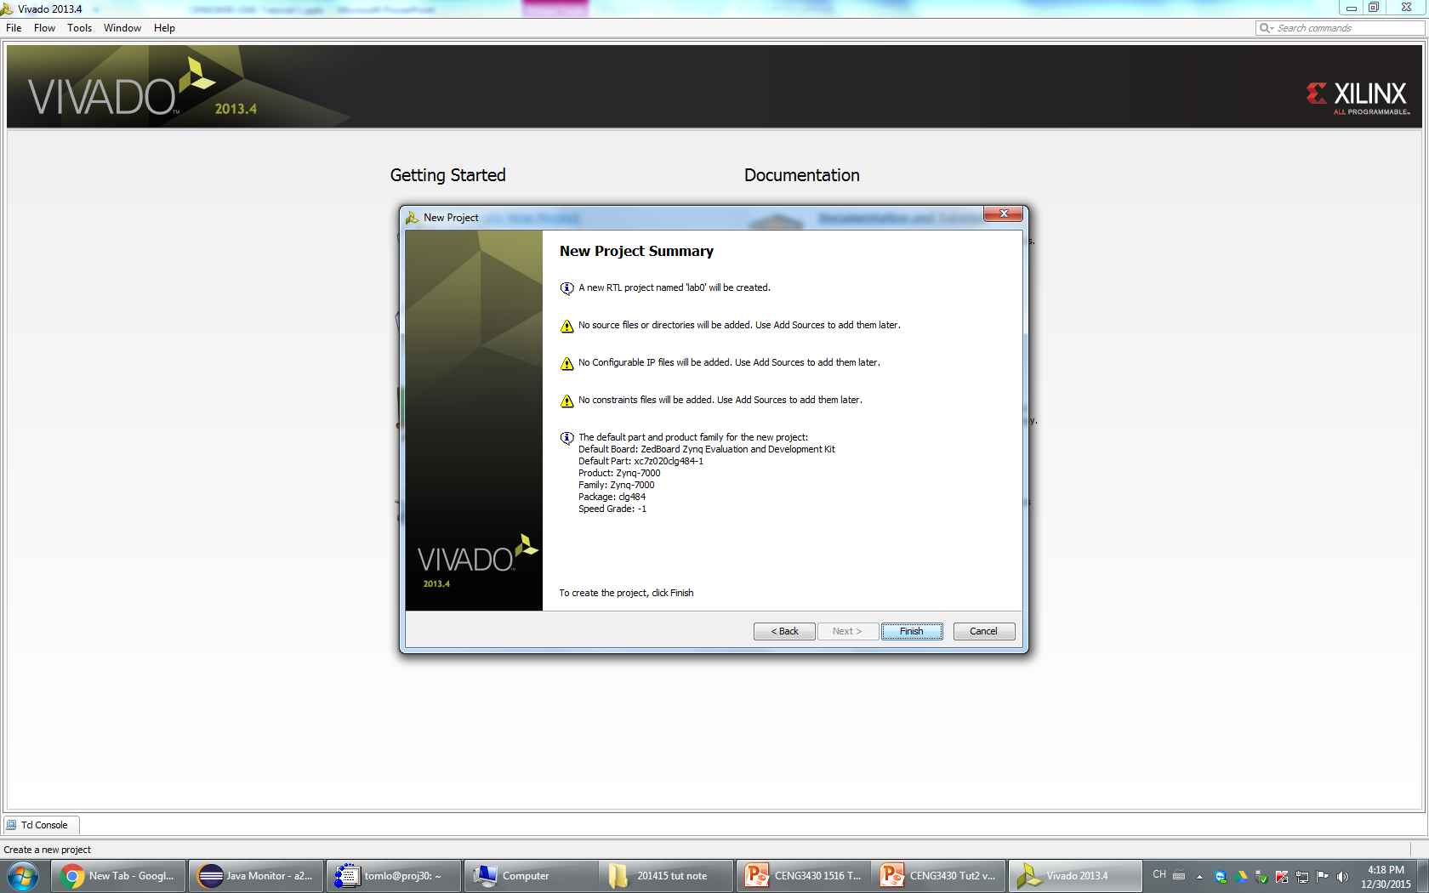
Step 10: Click Finish

Slide 14
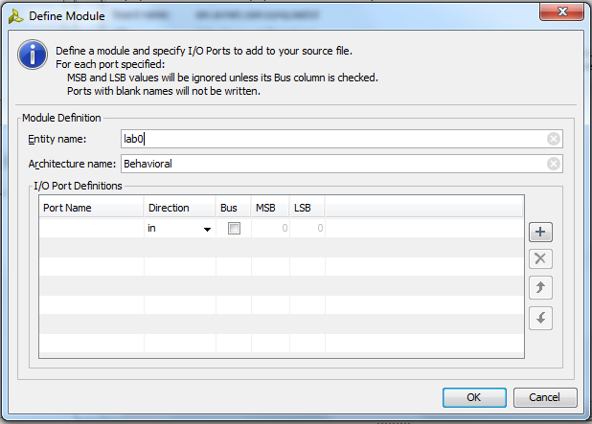
Step 10: If you see this box, just click OK

Slide 15
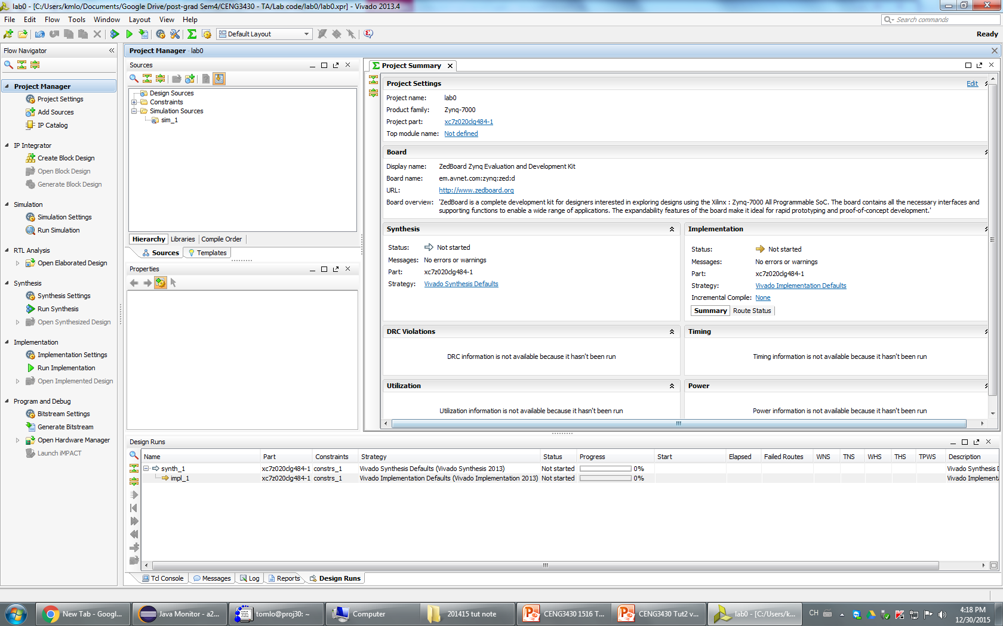
Now we can start writing our code
This is the programming interface :
Select different tools
Shows the IDE status / warning / error message

Slide 16
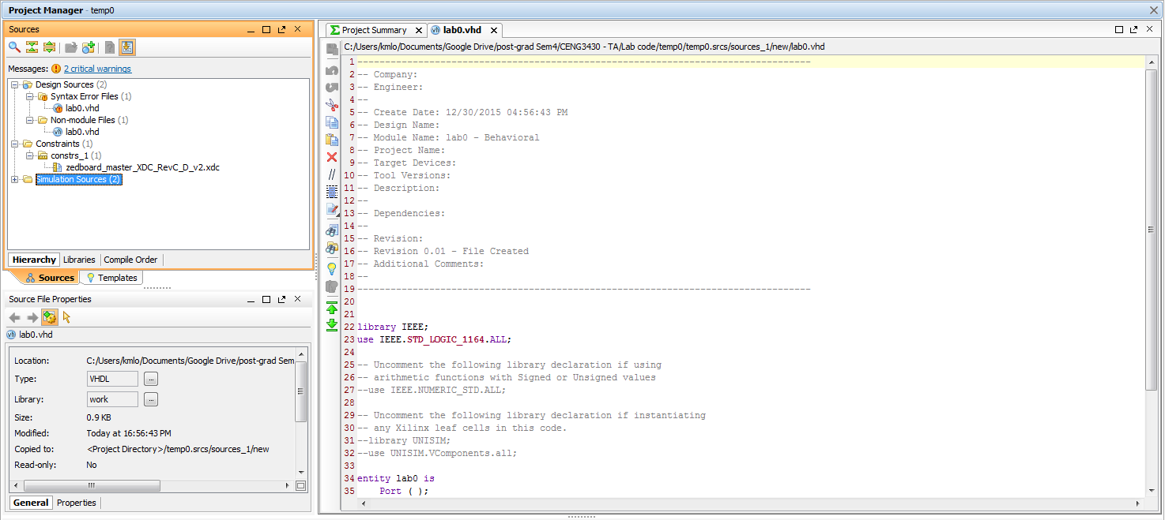
In the source directory, you will see the source file created in Step 6.
Double click to open it.
(It is normal to see the file name appears twice in syntax error files and non-module file if the source code is empty or has syntax error)

Slide 17
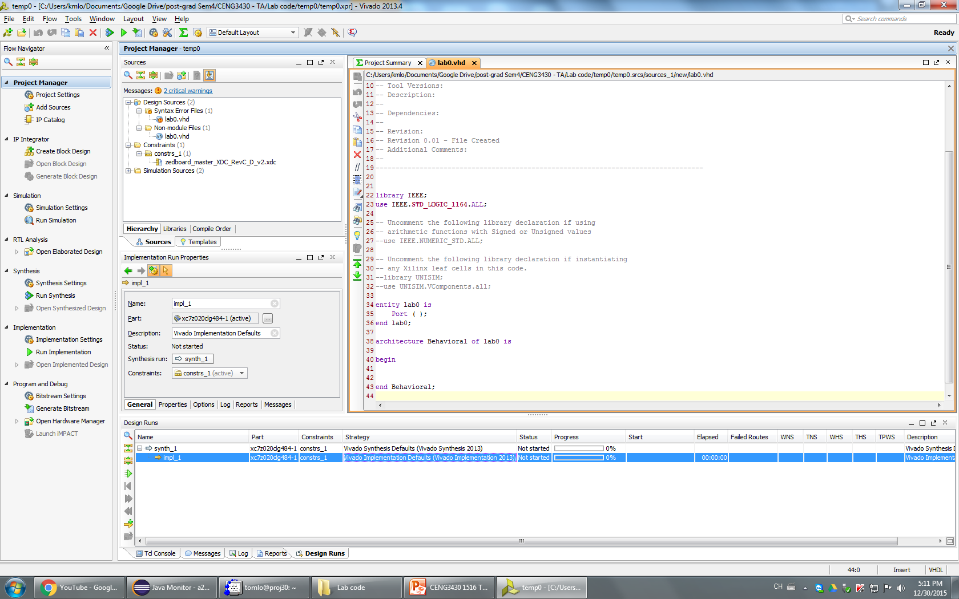
Copy the code downloaded file eLearning

Slide 18
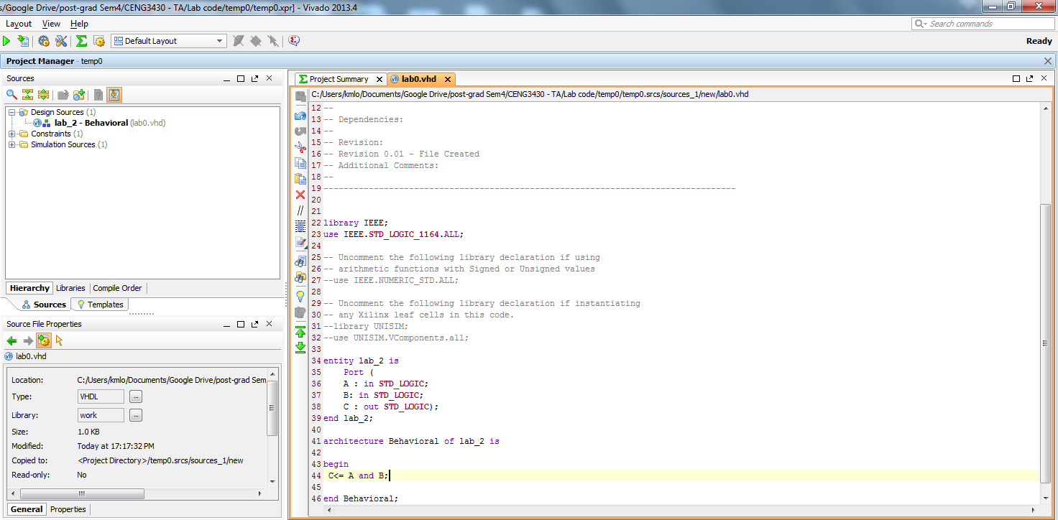
After saving the code, the source directory should look like this

Slide 19
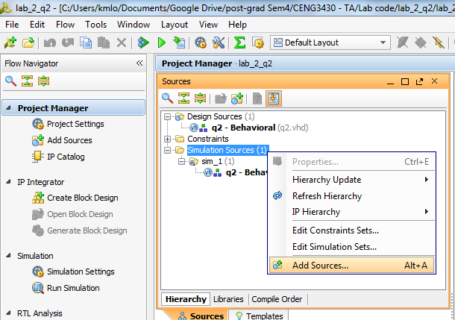
How to write a testbench?
After finishing your source code
Under the source window, right click on the simulation sources
-> Add sources

Slide 20
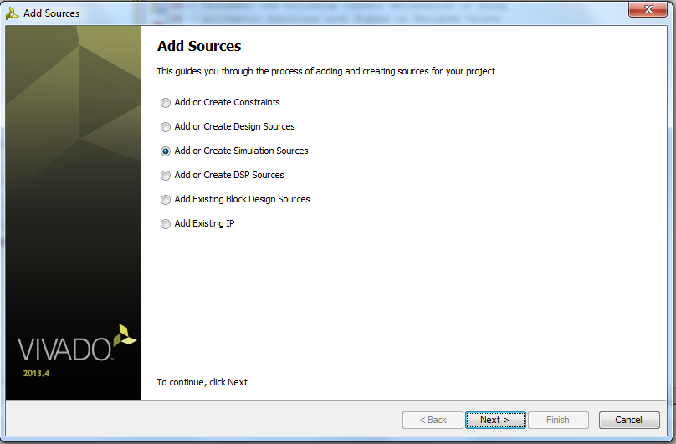
Select “Add or Create Simulation Sources” -> Next

Slide 21
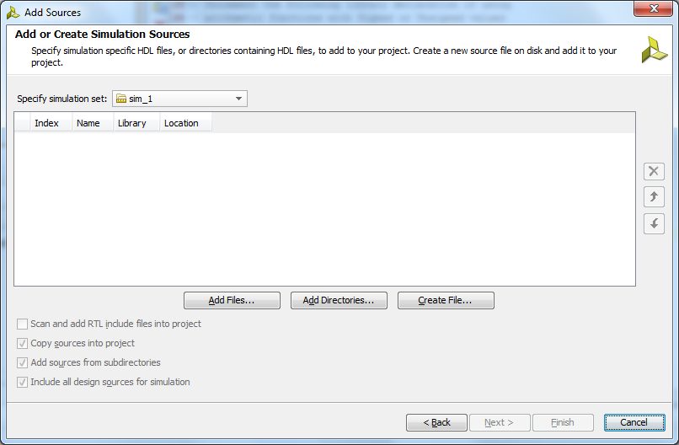
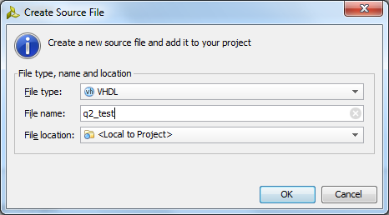
1.
2
4
3
Click “Create File” -> Get the testbench a name
(Usually same name with your source code, adding _test as postfix)
-> “OK”->”Finish”

Slide 22
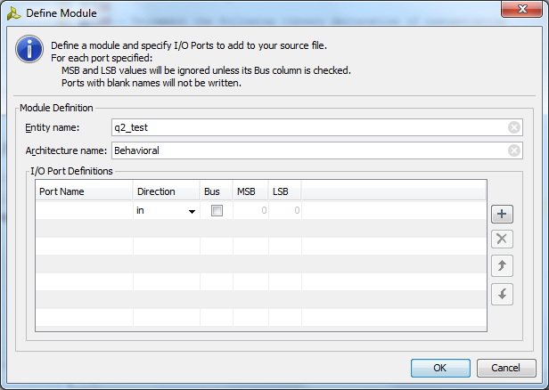
If you see this window, just click OK

Slide 23
Generating testbench file
In Vivado, the testbench file will not generate automatically
(But the older software can do that… )
Go to http://vhdl.lapinoo.net/
Paste your main board source code on it, the website will generate the testbench file for you
Copy the generated content, replace all content in the Vivado testbench file

Slide 24
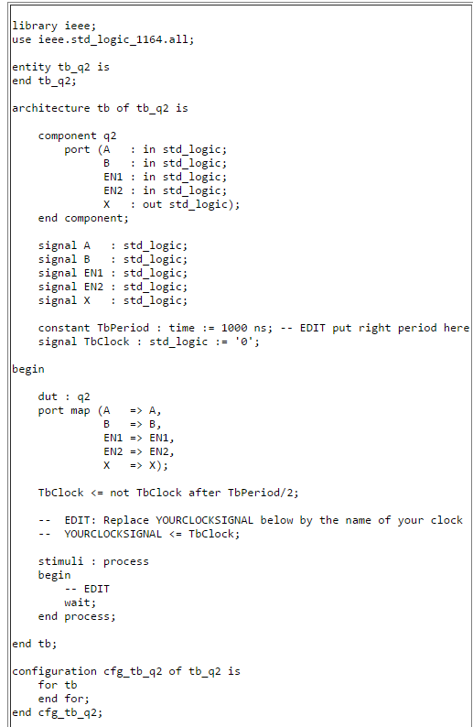
Unfortunately, the generated content have to modify before we execute…
Change the name, to match the name of testbench
For example :
A <= '0';
EN0 <= '0';
wait for 100 ns;
A <= '1';
EN1 <= '0';
wait for 100 ns;
Which means you force a constant 0 to A / EN0 for 100ns
After that, you force a constant 1 to A / 0 to EN0 for 100ns
<-Add your test case here
“end tb;” change to “end;”
Remove those line

Slide 25
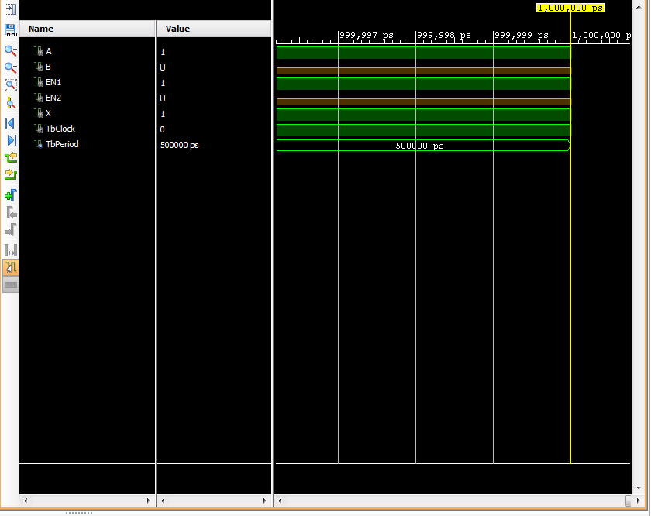
Now you can run simulation
Flow Navigator->Run Simulation->Run Behavioral Simulation
Click this

Slide 26
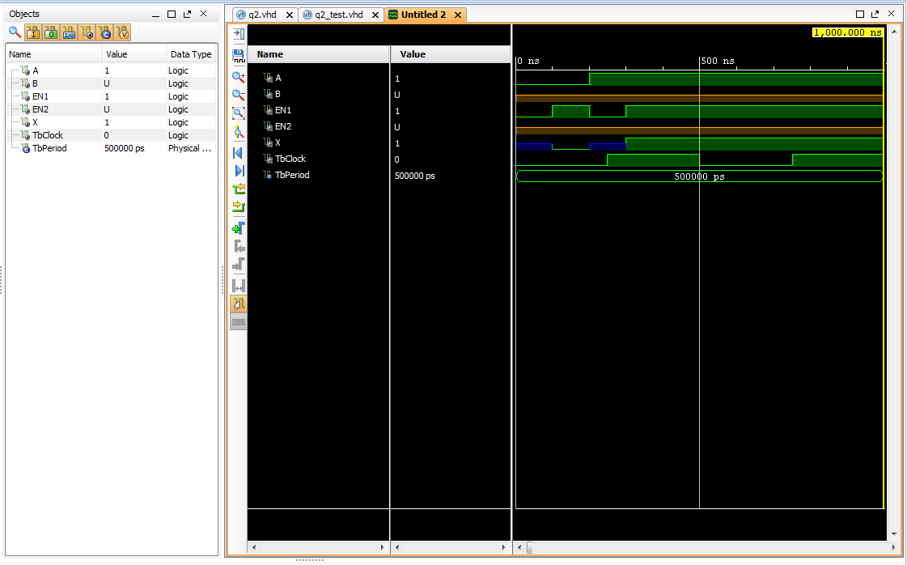
Now you can see the result
To adjust the width, modify tbPeriod in the testbench

Slide 27
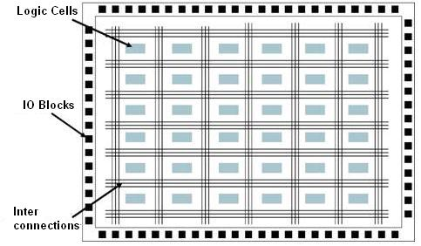
XDC file
FPGA is different from the embedded system
The input/output pins are configurable
We have to tell vivado which ports we would like to use as input/outputs by modify the XDC file
Program the inter connections

Slide 28
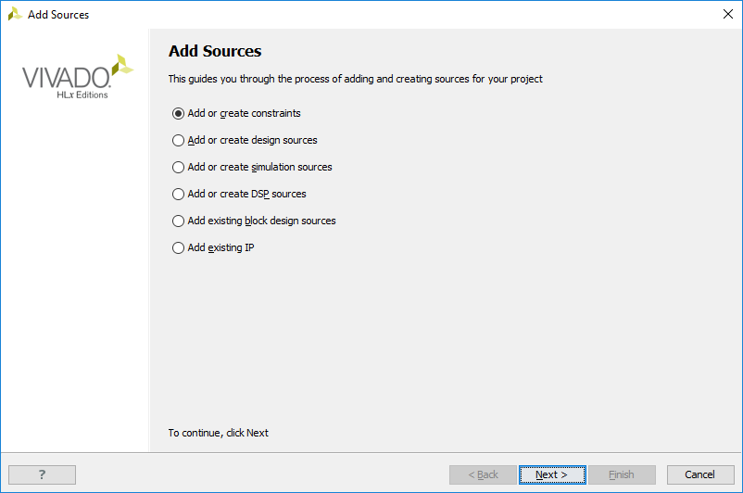
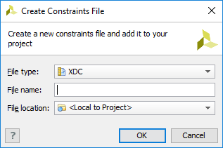
Create XDC file
Click “File->Add Sources->Add or create constrain->Create File->OK”
Enter file name
Press OK

Slide 29
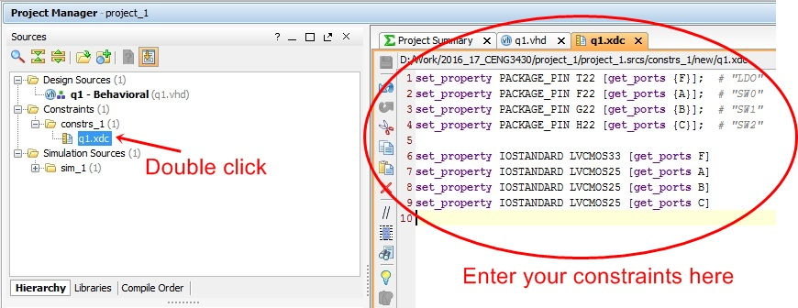
Create XDC file
Double Click “your_new_created.xdc” file. Enter the constrains.

Slide 31
Electrical specification
The zedboard has eight user leds, LD0 – LD7. A logic high from the zynq-7000 AP soc I/O causes the LED to turn on. LED’s are sourced from 3.3V banks through 390Ω resistors. [p20, (Zynq evaluation and development) hardware user’s guide]
set_property IOSTANDARD LVCMOS33 [get_ports F]

Slide 32
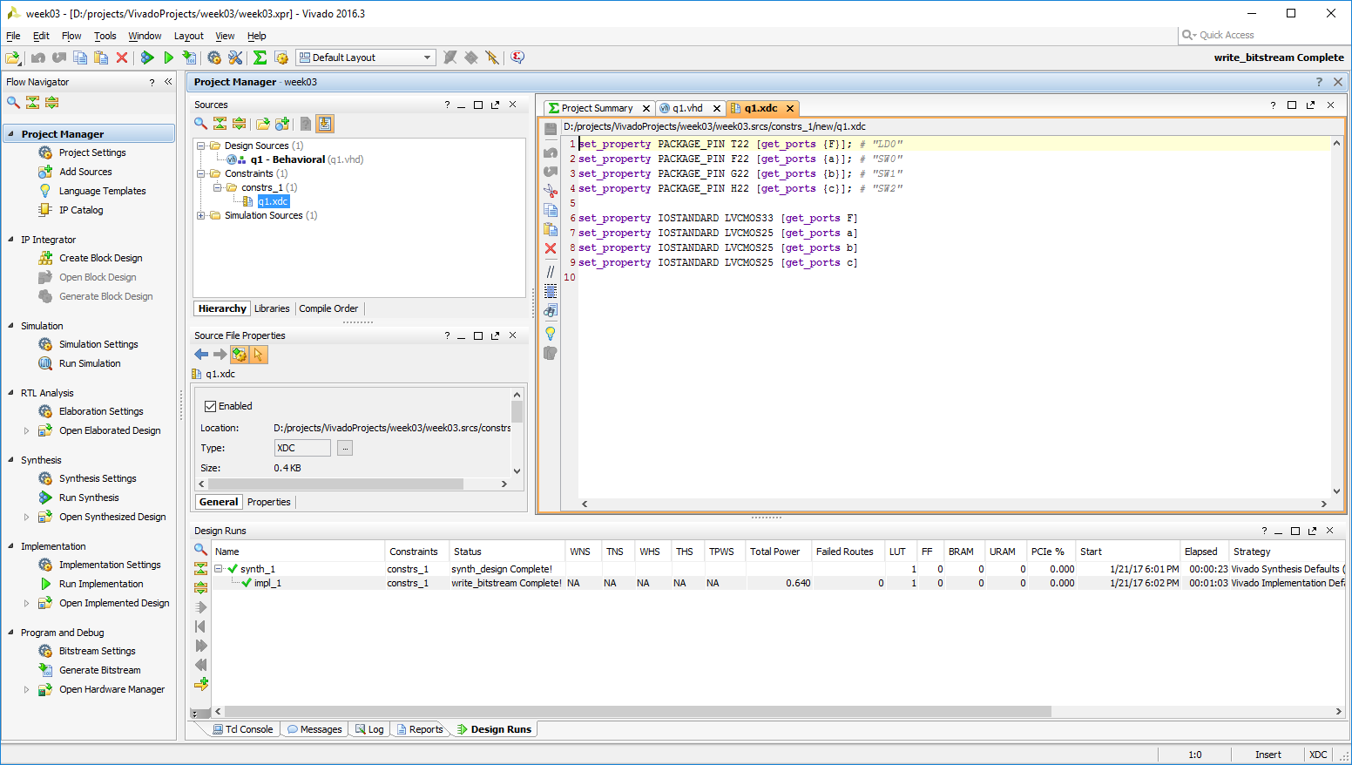
Synthesis, implementation and generate bitstream
Click “Generate Bitstream”

Slide 33
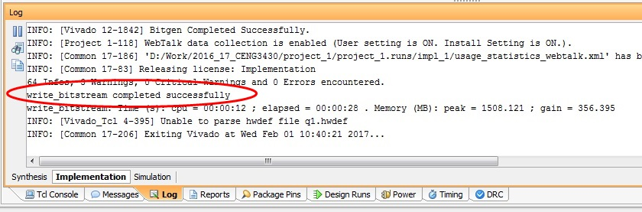
Synthesis, implementation and generate bitstream
If there is no error then you will see the successful message on the log as shown on the picture.

Slide 34
Reference
Zedboard docs
http://zedboard.org/sites/default/files/documentations/ZedBoard_HW_UG_v2_2.pdf
Vivado design suite user guide – using constraints
https://www.xilinx.com/support/documentation/sw_manuals/xilinx2012_2/ug903-vivado-using-constraints.pdf

